Slide 1
मानसिक स्वास्थ्य के लिए
आयुर्वेद
AYURVEDA FOR MENTAL WELL BEING

Slide 2
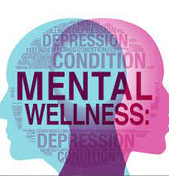
BURDEN OF MENTAL DISORDERS
Depression
Bipolar Disorder
Schizophrenia
Dementia
264 million
45 million
20 million
50 million

Slide 3
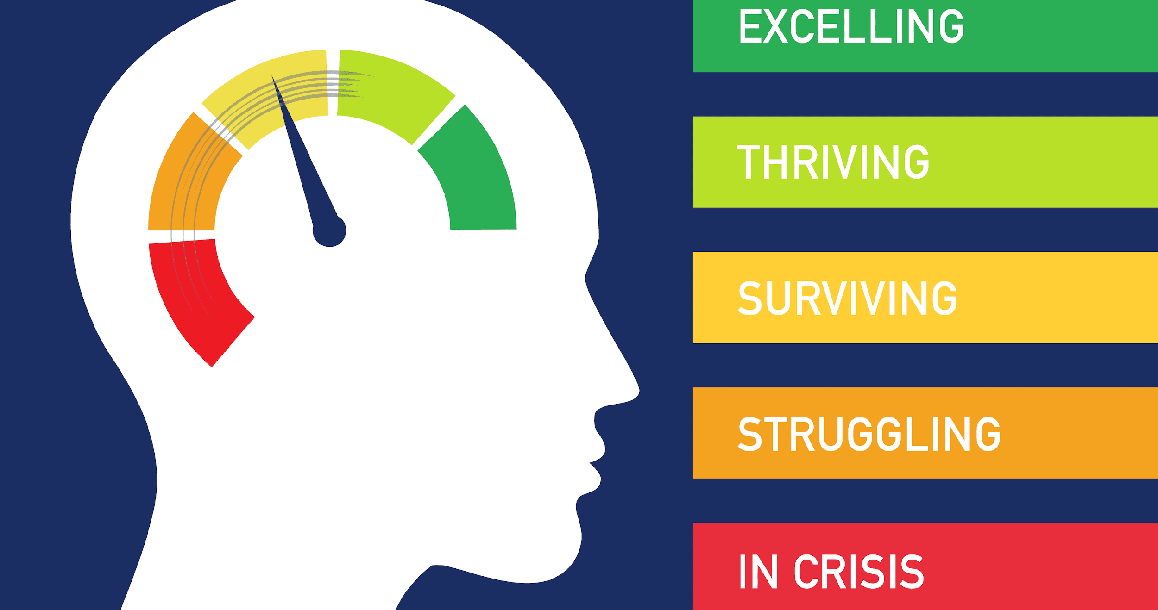
WHAT ABOT YOU??

Slide 4
WHAT IS NOT A MENTAL DISORDER
Experiencing the emotions of anxiety and depression at some stage of life is very common to everyone
All unpleasant emotions are due to psychological disorders, unless they don’t have any diagnosable illness
Some don’t need to seek any medical help to come back normal

Slide 6
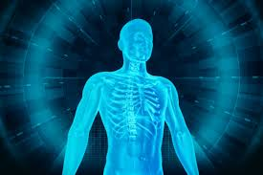
IMPORTANCE OF MENTAL HEALTH
Balanced Dosha
Samadosha
Balanced enzymes & metabolites
Samagni
Balanced tissue system
& state of excretory functions
Sama dhatu mala kriya
Prasanna
Ātma –Indriya- Manaha
Soul, sense organs and mind

Slide 7
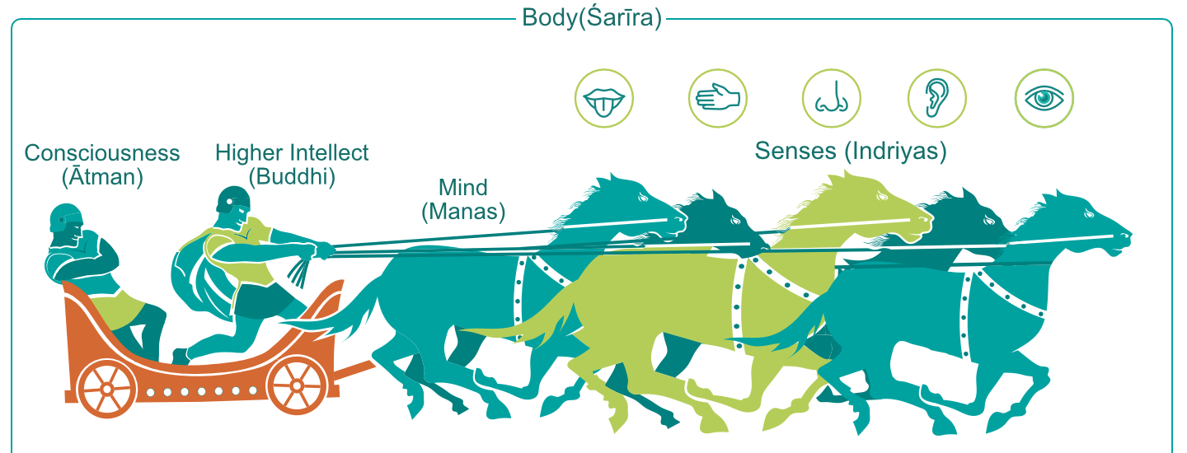
ROLE OF PROPER MENTAL HEALTH
MOTOR FUNCTIONS
MIND (MANAS)
SENSORY FUNCTIONS

Slide 8
FUNCTIONS OF MIND
Functions of Mind
मन के कार्य
Inference
Analyzing b/w good & bad
Thinking
Focus
Determination based on vicharam
ऊह्य
विचार्य
चिंता
ध्येय
संकल्प
Whenever Rajas & Tamas increases and the functions of mind are compromised, Mano rogas develops/
जब भी रजस और तमस बढ़ते हैं और मन के कार्यों मे बाधा आती है, तो मनो रोग विकसित होते है

Slide 9
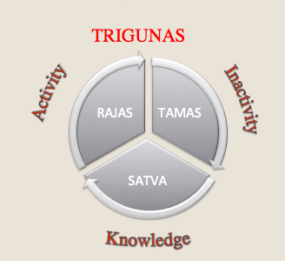
DOMAINS OF MENTAL HEALTH
The ideal state of mind is Satvic.
Rajas is the Active force behind the Movement of both sensory and motor organs.
Tamas gives rise to the elements, which Form the basis of material creation
Ayurveda also says that negative feelings are emotional toxins., they give rise to chronic mental disorders like Anxiety, Neurosis, and depression.

Slide 10
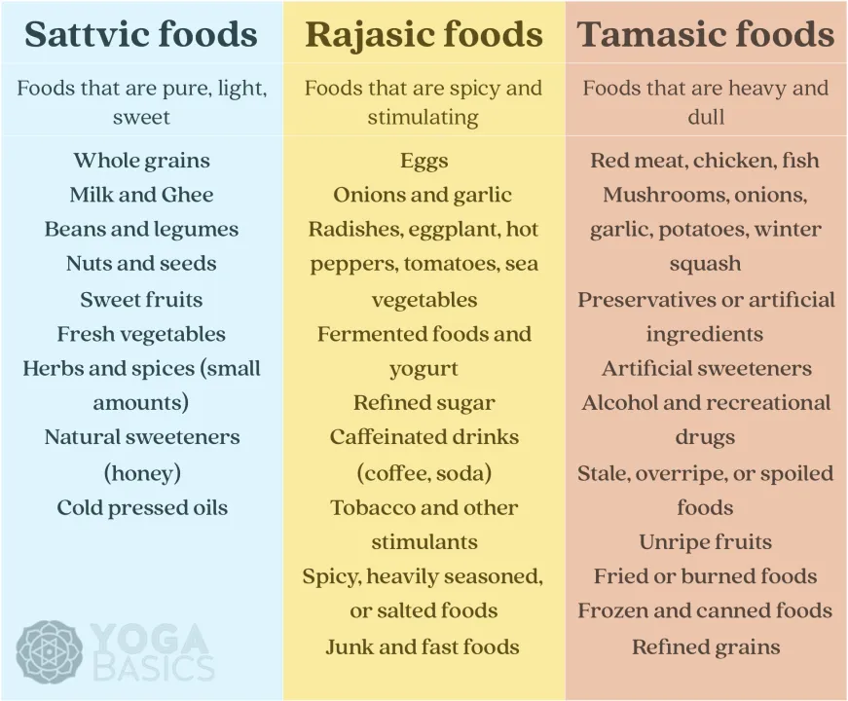
NUTRITION & MENTAL HEALTH

Slide 11
SOME COMMON MENTAL DISORDERS
Anxiety disorders, including panic disorder,
Obsessive-Compulsive Disorder, and Phobias
Depression, bipolar disorder, and other mood disorders
Eating disorders
Personality disorders
Post-traumatic stress disorder
Psychotic disorders, including schizophrenia

Slide 12
SOME COMMON CAUSE
Emotional stress
Occupational stress
Trauma
Poor upbringing
Repressive religion
Influence
From disturbed individuals
Sexual abuse
Perversion
Drugs
Excess thinking
Excess Anger/hate/ fear/nervousness/ worry/ apathy
Dullness/ sleeplessness.

Slide 13
TREATMENT MODALITIES IN AYURVEDA
PREVENTIVE

Slide 14
DINACHARYA
(PROPER DAILY ROUTINE)

Slide 15
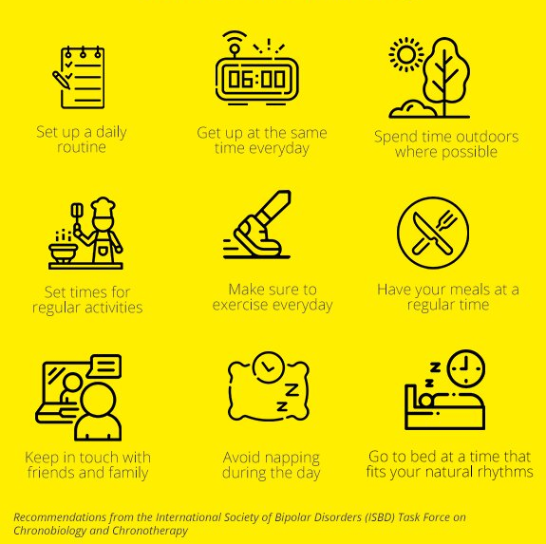

Slide 16
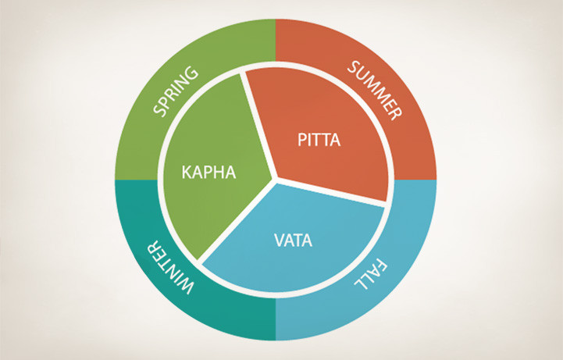
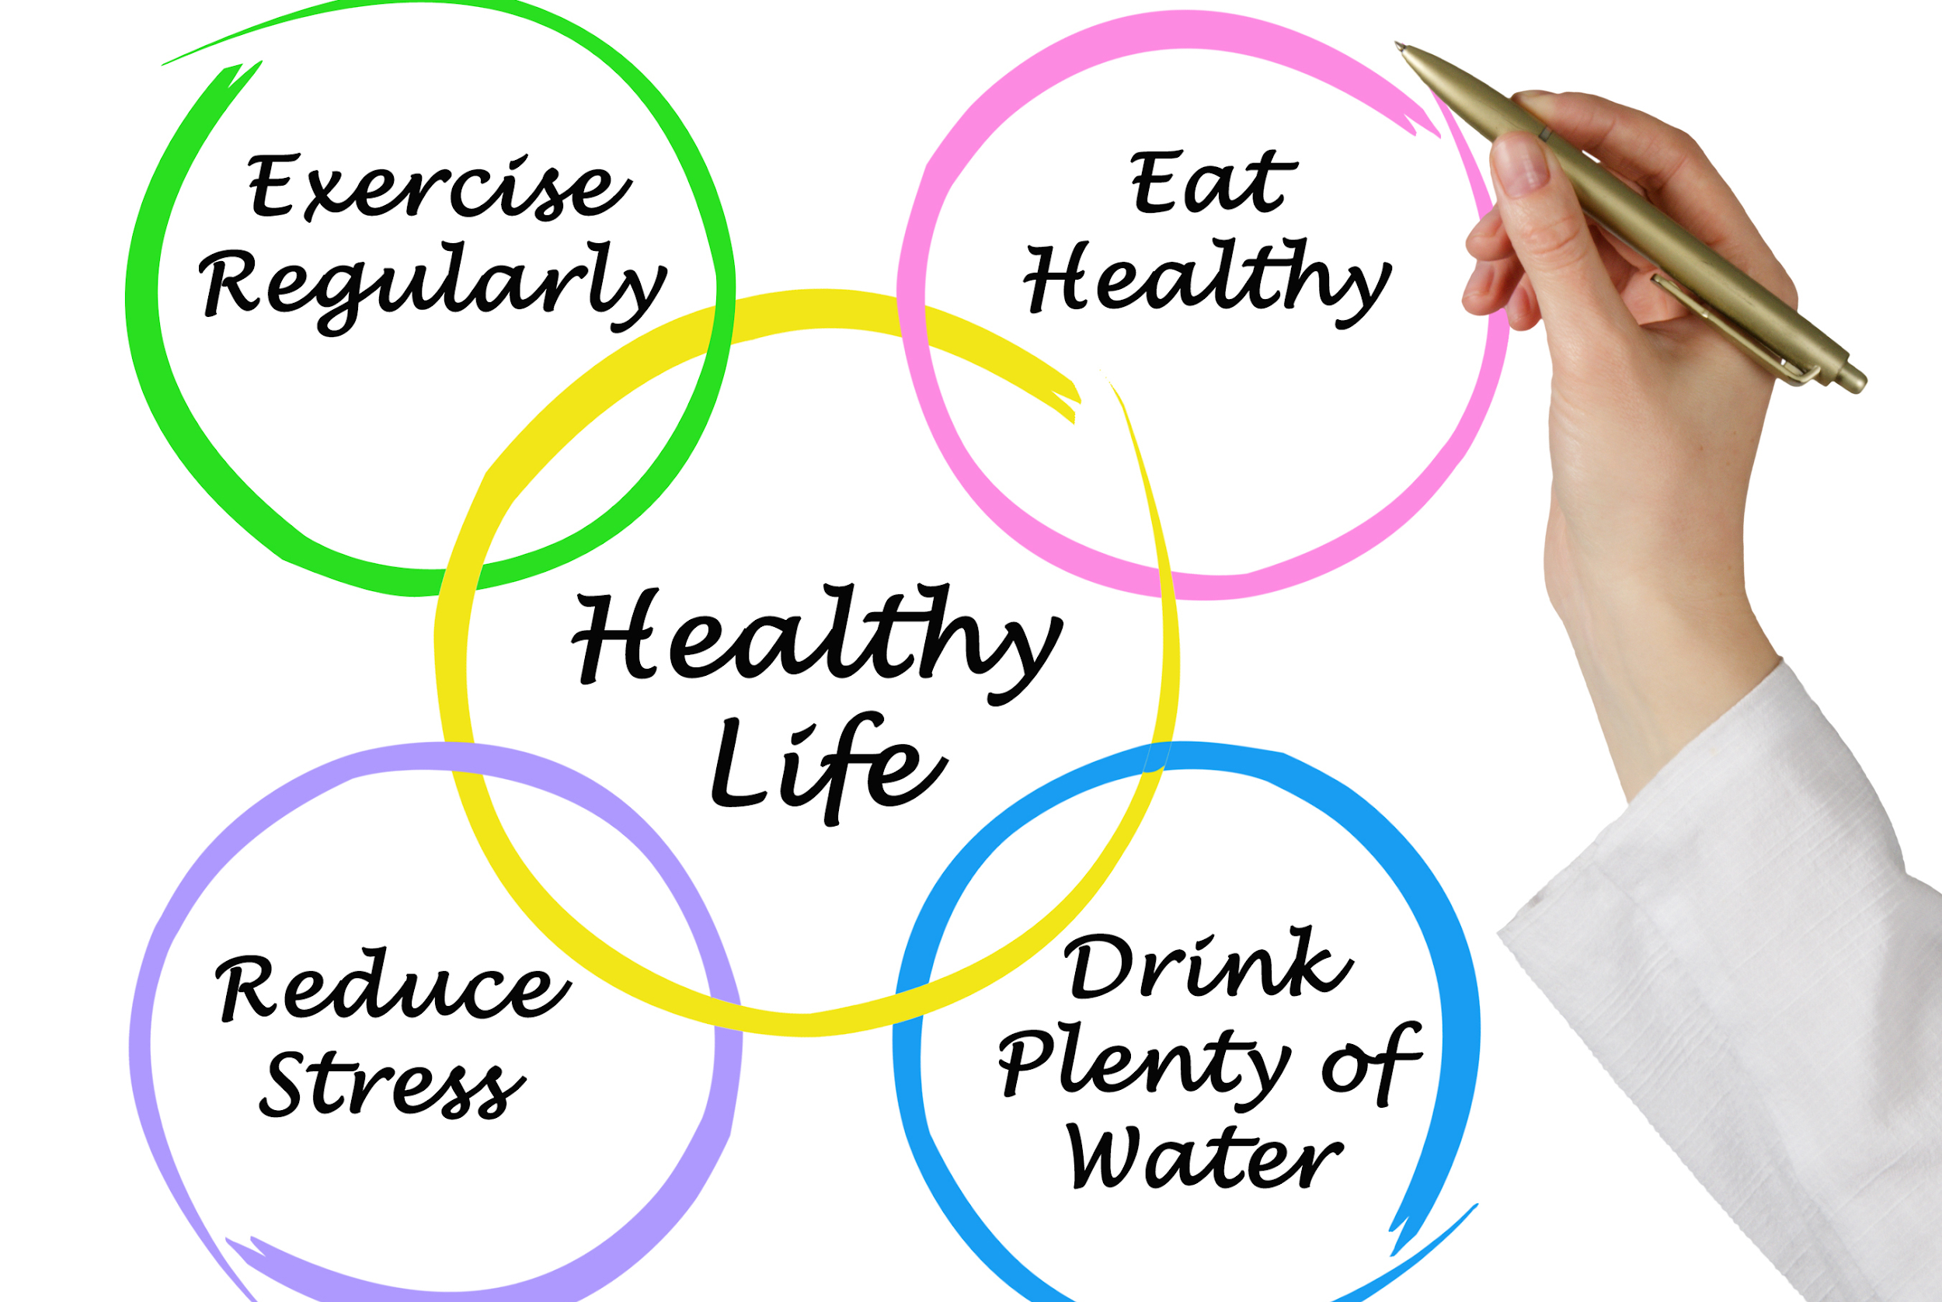
RITUCHARYA (SEASONAL ACTIVITIES)

Slide 17
ACHARA RASAYANA
A person must be truthful, free from anger
Should be devoid of alcohol, sex indulgence
A person must not indulge in violence or exhaustion.
A person may regularly offer prayers to Gods, Teachers, Preceptors and old people.
A person must be free from barbarous acts,
His period of awakening and sleep is regular, must take milk and Ghee regularly,

Slide 18
ACHARA RASAYANA
Should be free from ego, Whose conduct is good, must not be narrow minded,
Should have love for spiritual Knowledge, must have excellent sense organ,
having self control, who regularly read scripture, must have regard for elderly people, must take milk and Ghee regularly.

Slide 19
WORK LIFE BALANCE
8 Hours Sleep
4 Hours Personal time
8 Hours Dedicated working Hours
4 hours fruitful with family and friends

Slide 20
TREATMENT MODALITIES IN AYURVEDA
CURATIVE &
RESTORATIVE

Slide 21
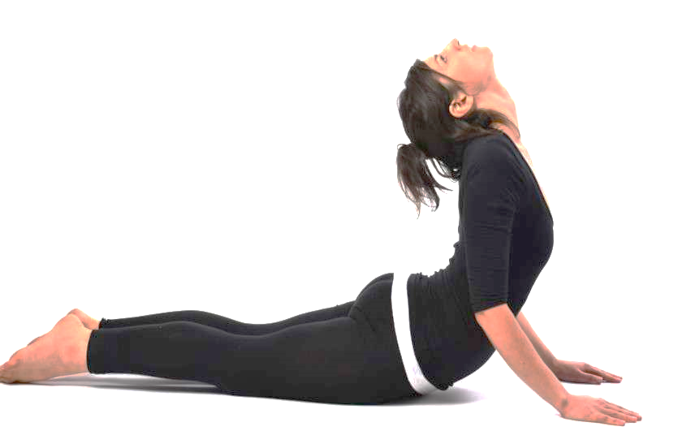
YOGA & PRANAYAMA
Asana practices improves Chest expansion and Cardio-pulmonary functions
Asana stretch & relax nerves, muscles and promote free flow of energy throughout body
They nourish & tone specific and neglected Organs and Glands
https://www.ayush.gov.in National Clinical Management Protocol based on Ayurveda and Yoga for management of Covid-19

Slide 22
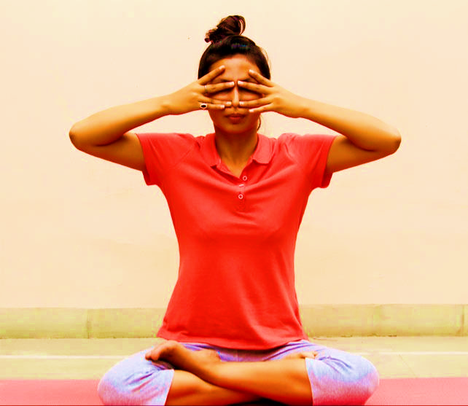
YOGA & PRANAYAMA
Pranayama stimulates vagal (parasympathetic) activity and decreases stress (reduce Cortical - the stress hormone) and anxiety
Increase anti-oxidant protection
Bhramari pranayama improve blood flow to the ciliary epithelium and has anti-inflammatory actions

Slide 23
YOGA & PRANAYAMA
It increase the oxygen saturation in body
Enhances Brain function
Normalizes brainwave patterns
It boosts Immune System
Pranayama brings peace and steadiness

Slide 24
MEDHYA RASAYANA AND MENTAL HEALTH/ मानसिक स्वास्थ्य
Glycyrrhiza glabra L.
Tinospora cordifolia (WILLD.) HOOK.F. & THOMS.
Bacopa monnieri (L.) PENNELL
Convolvulus prostratus FORSSK.
Withania somnifera DUNAL
functions like imipramine/
ईमिप्रमिन के तरह काम करता हे
increases retention memory/ स्मरण शक्ति को बढाता हे
mood stabilizer/ भावो को स्थिर करने वाला
Blocking serotonin uptake/ सिरोटोनिन के अवशोषण को रोकना
Inhibits MAO/ एम.ए.ओ को रोकना

Slide 26
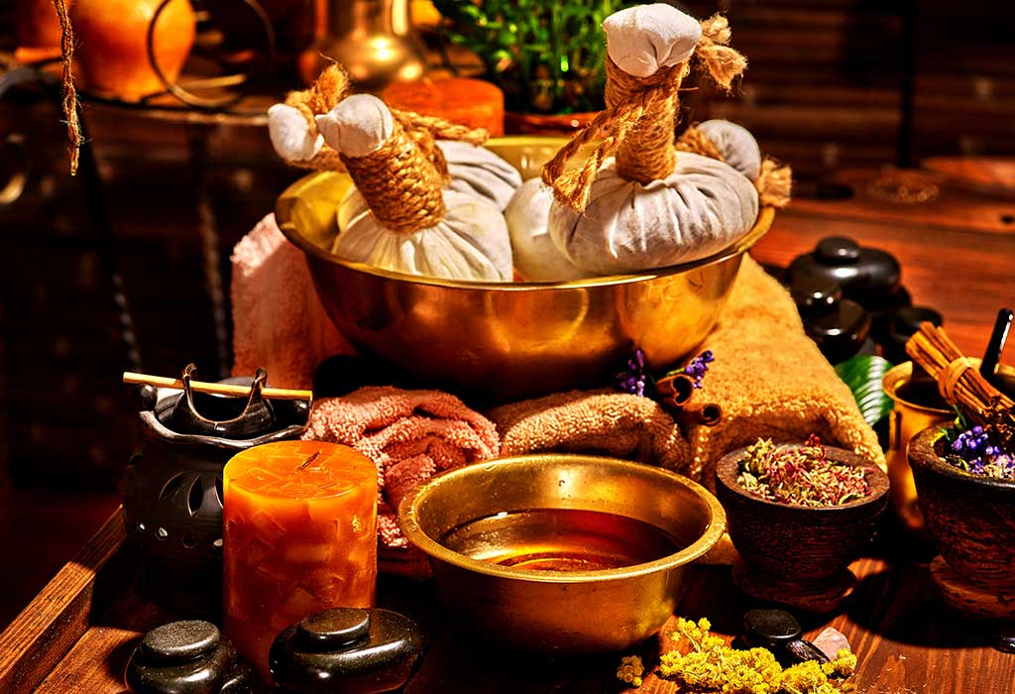
THE UTILITY OF PANCHAKARMA IN MENTAL HEALTH
Pradhana karmas (operative procedures)
Bahya karmas (external therapies).

Slide 27
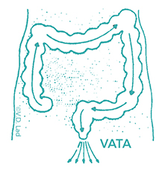
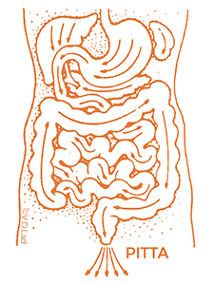
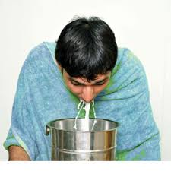
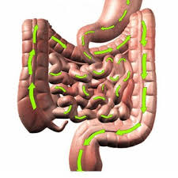
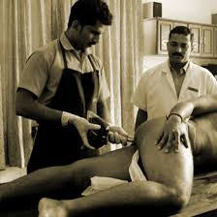
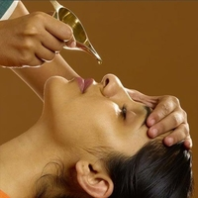
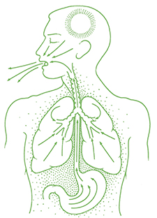
PANCHAKARMA
VAMANA
VIRECHAN
VASTHI
NASYA
KAPHA

Slide 28
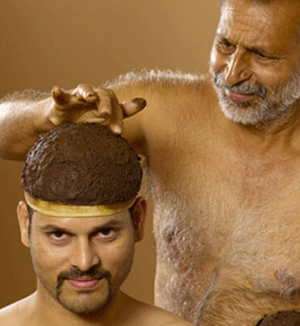
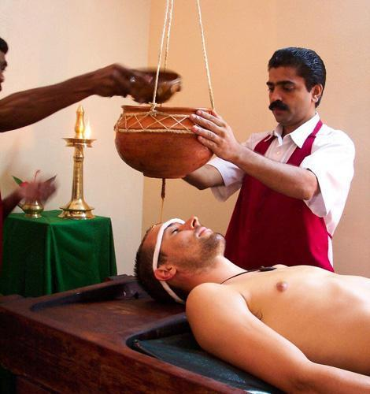
TALAPOTHICHIL
SHIRODHARA

Slide 29
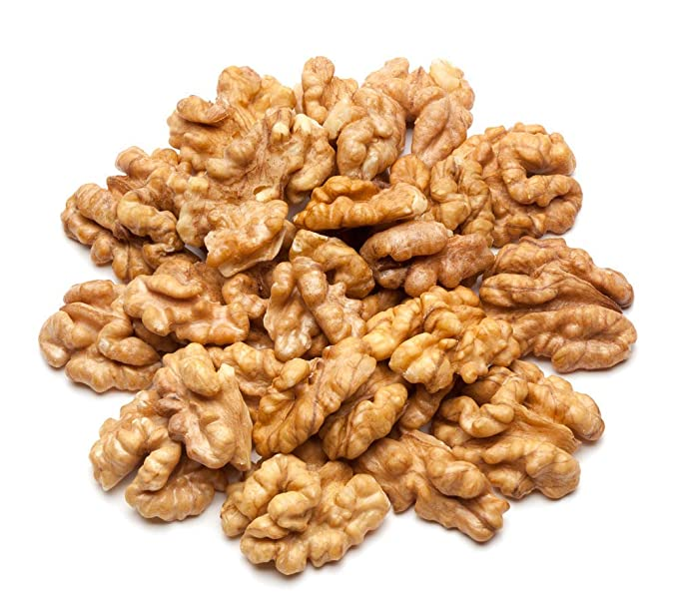
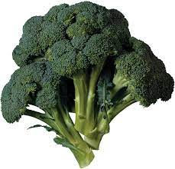
THE FOOD FOR MENTAL HEALTH
Walnuts are another rich, plant-based source of omega-3 fatty acids. support overall brain health.
Deficiency in DHA (the chief omega) is associated with mental health disorders, including depression, ADHD, bipolar disorder, and schizophrenia
Low folic acid is associated with depression. As a result, folate is an important food for mental health. And broccoli is high in folate, as well as fiber and vitamin C.

Slide 30
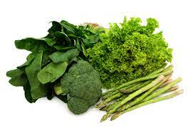
THE FOOD FOR MENTAL HEALTH
Dark Leafy Greens Folate (a form of vitamin B9), Magnesium, and Omega-3s all support mental health and brain health.
Bean contain fiber, beans also help to stabilize blood sugar levels.
Beans also contain tryptophan, which supports healthy serotonin production. As a result, it is a great food for mental health.

Slide 31
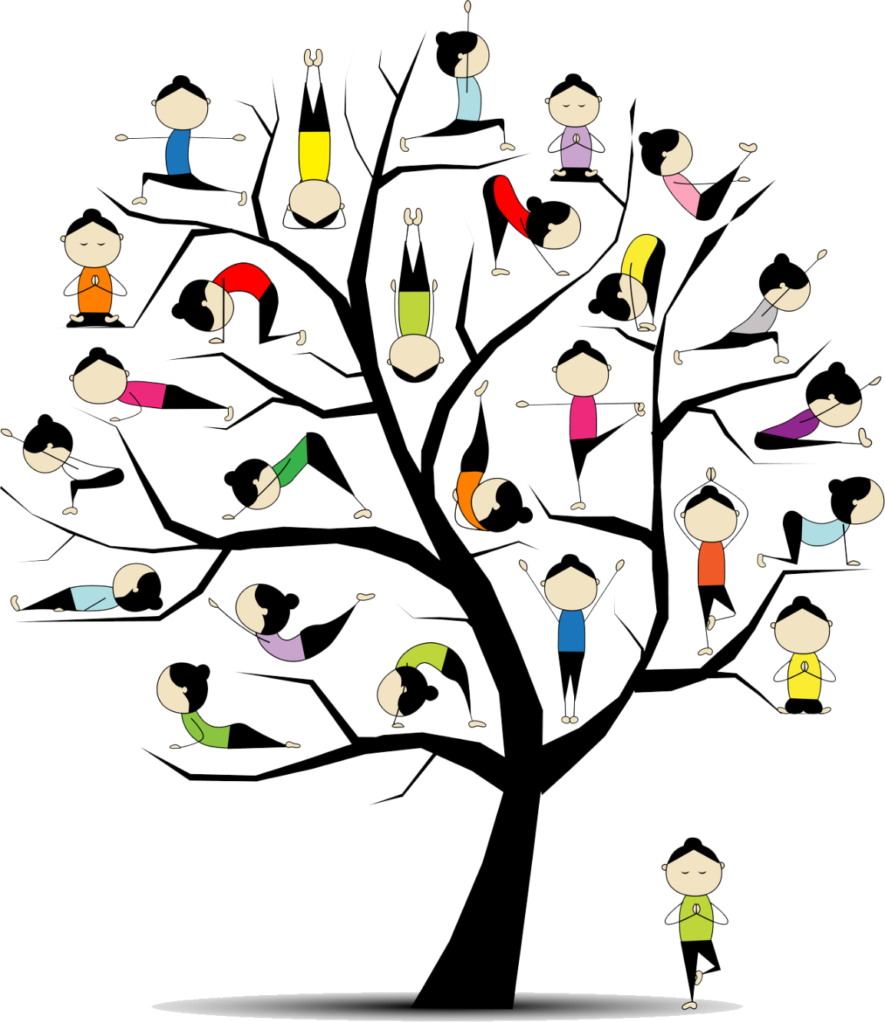
Thank you..

Slide 32
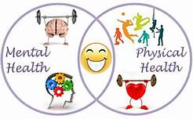
ALL INDIA INSTITUTE OF AYURVEDA (AIIA) Care with Compassion
Holistic approach
AIIA
Proper Diet
Traditional medicines with modern equipments
Yoga and meditation

